Slide 1


Slide 2

Data Analytics with Python
Dave Enright – Data and Analytics Consultant, Amazon Web Services
Kyaw Zin Latt – Cloud Developer, Telstra

Slide 3

Course Outline
Why Python?
Demo
Introduction to Python
Exercise
NumPy
Exercise
Pandas and Data Frames
10 Minutes Break
Data Cleansing
Exercise
Visualisation
Exercise
Self Learning

Slide 4
Why Python?
Programming Fundamentals
Programming languages typically come in two flavors: Compiled and Interpreted
Compiled languages need to be converted to machine language before they run, interpreted languages can be converted to machine languages as they run
JavaScript is the language the web runs on, and it is an example of an interpreted language. It loads the webpage on the fly in your browser, imagine if you had to download each website onto your computer to run it first?
Python also traditionally is an interpreted language
In data science and analytics, you are constantly making changes to your code, thus it’s a lot more convenient to use an interpreted language as it’s very easy to update and adjust on the fly

Slide 5
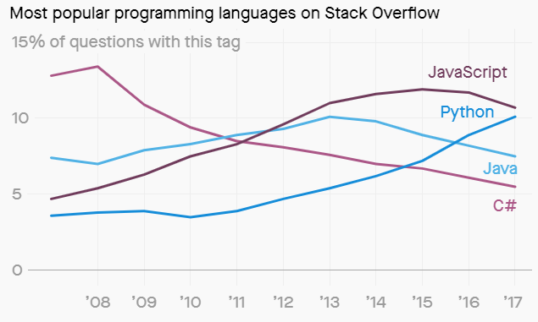
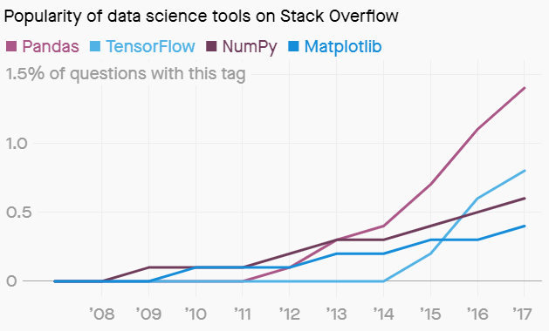
Why Python?
The rise of Python
Flexibility
Easy to Learn
Excellent Data Science Libraries
Source: Stack Overflow

Slide 6
Why Python?
Why Learn Python?
Nature of python makes it a great fit for data analytics.
General purpose language
Easy to learn compared to other languages
Readable
Extensive set of libraries
Easy integration with other apps
Active community & ecosystem
Deals with files well
Job opportunities – python is in demand!
R - from Statisticians community – great for queries of data in databases
Python - from Computer Science community – can tackle data and analytics problems end to end (from data ingestion to model deployment)

Slide 7
Why Python?
Python vs Excel
Why use Python over Excel?
Python works better on large datasets
Python notebooks can be published and shared easily on the internet
It’s easier to do complex operations with python, such as manipulating a lot of data at once, or AI and machine learning
You can document, graph, and code in the one place
Python allows you to automate tasks such as data loading, model deployment, and model optimisation
However:
Python does require programming knowledge
Python requires server infrastructure to use at scale
If someone does not have python on their local computer, they cannot modify or run your code
Excel is still a good tool for small datasets or simple data manipulation
Use the best tool for the job.

Slide 8
Demo

Slide 9
Setting up Juypter Notebooks
Exercise

Slide 10
Introduction to Python

Slide 11
Introduction to Python
Python Basic Recap: Variable
A variable is a label to store information to be referenced throughout your program.
For example, your name is a variable that references you.
Variables can be called to bring back the stored value.
With a variable, your code becomes easier to read, maintain, and extend.
In [1]: sales = 100
In [2]: cost = 50
In [3]: sales
Out [3]: 100
In [4]: profit = sales – cost
In [5]: profit
Out [5]: 50

Slide 12
Introduction to Python
Python Basic Recap: Python Types
Python classifies data into different data types:
str – Text, String (e.g. “Bank”),
int - Whole number (e.g. 100),
float – Decimal, Real Number (e.g. 1.5),
boolean - Logical Values (e.g. True, False)
Data type defines how the values is stored in the computer, and operations that can be done on the data.
For example you can add integers together, it will sum. When you add strings together, it will concatenate.
Different data types have different behaviours
In [1]: 2 + 5
Out[1]: 7
In [2]: ‘Citi’ + ‘Bank’
Out[2]: ‘CitiBank’
In [3]: type(‘CitiBank’)
Out[3]: <class ‘str’>
Notes:
e.g. “Blk 100” is a string although there is a number in it.

Slide 13
Introduction to Python
Python List
Lists are an important way of storing and manipulating data in python, in order to gain quick insights without writing a lot of code
Consider sales data for 4 years stored in four different variables:
sales_year1 = 100
sales_year2 = 120
sales_year3 = 130
sales_year4 = 150
It’s very inconvenient/inefficient to store data in individual variables. It is much easier to store in a list:
sales_list = [100, 120, 130, 150]
Gives a single name for a collection of values.
The elements within List can be any type.
Notes:
e.g. “Blk 100” is a string although there is a number in it.

Slide 14
Introduction to Python
Python List
sales_list = [100, 120, 130, 150]
Lists can contain different data types
sales_list = [‘year1’, 100, ‘year2’, 120, ‘year3’,130, ‘year4’, 150]
List can also contain List, this is known as nesting.
[‘year1’, 100]
[‘year2’, 120]
[‘year3’, 130]
[‘year4’, 150]
sales_list2 = [[‘year1’, 100],
[‘year2’, 120],
[‘year3’, 130],
[‘year4’, 150]]
Notes:
e.g. “Blk 100” is a string although there is a number in it.

Slide 15
Introduction to Python
Accessing information in the List: Subsetting
Python uses an index to access the values. Like most programming languages, it’s a zero-based index (starts at 0, not 1)
In []: sales_list
Out[]: [‘year1’, 100, ‘year2’, 120, ‘year3’,130, ‘year4’, 150]
Index: 0 1 2 3 4 5 6 7
Suppose you want to access year 3 sales data:
In []: sales_list[5]
Out[]: 130
This is known as subsetting
Notes:
e.g. “Blk 100” is a string although there is a number in it.

Slide 16
Introduction to Python
List: Slicing
Select multiple elements from List, thus create a new list
Specify a range with a colon ( start : end )
In []: sales_list
Out[]: [‘year1’, 100, ‘year2’, 120, ‘year3’,130, ‘year4’, 150]
Index: 0 1 2 3 4 5 6 7
Get sales data for year2 to year3:
In []: sales_list[2:6]
Out[]: [‘year2’, 120, ‘year3’, 130]
[ start : end ]
inclusive exclusive
Notes:
e.g. “Blk 100” is a string although there is a number in it.

Slide 17
Introduction to Python
List: Slicing [start : end]
In []: sales_list
Out[]: [‘year1’, 100, ‘year2’, 120, ‘year3’,130, ‘year4’, 150]
Index: 0 1 2 3 4 5 6 7
Omit start, Python starts from index 0
Omit end, instruct Python to look until the ends of list
In []: sales_list[:4]
Out[]: [‘year1’, 100, ‘year2’, 120]
In []: sales_list[4:]
Out[]: [‘year3’, 130, ‘year4’, 150]
Notes:
e.g. “Blk 100” is a string although there is a number in it.

Slide 18
Introduction to Python
List: Manipulation
In []: sales_list
Out[]: [‘year1’, 100, ‘year2’, 120, ‘year3’,130, ‘year4’, 150]
Index: 0 1 2 3 4 5 6 7
In this example year4 sales data is wrong, it supposed to be 170…
In []: sales_list[7] = 170
In []: sales_list
Out[]: [‘year1’, 100, ‘year2’, 120, ‘year3’,130, ‘year4’, 170]
Suppose you want to add sales data for year 5…
In []: sales_list = sales_list + [‘year5’, 200]
Out[]: [‘year1’, 100, ‘year2’, 120, ‘year3’,130, ‘year4’, 170, ‘year5’, 200]
Notes:
e.g. “Blk 100” is a string although there is a number in it.

Slide 19
Introduction to Python
List: Manipulation
In []: sales_list
Out[]: [‘year1’, 100, ‘year2’, 120, ‘year3’,130, ‘year4’, 150]
Index: 0 1 2 3 4 5 6 7
Suppose you want to delete year1 along with its value from sales data list…
In []: del(sales_list[0:2])
In []: sales_list
Out[]: [‘year2’, 120, ‘year3’,130, ‘year4’, 150]
You can also update a part of the list…
In []: sales_list[0:2] = [’year1’, 115]
Out[]: [‘year1’, 115, ‘year3’,130, ‘year4’, 150]
Notes:
e.g. “Blk 100” is a string although there is a number in it.

Slide 20
Introduction to Python
List: Alias vs copy
When you assign a list to a variable, the list is stored in computer memory and creates a reference to the data for variable
In []: x = [“a”, “b”, “c”]
x
a
b
c
y
When you assign a list variable to another variable, it creates a reference to the list in the memory. This is known as Alias.
In []: y = x
Changing y will affect x, because they are referencing to the same list.
In []: y[0] = “d”
In []: x
Out[]: [“d”, “b”, “c”]
Notes:
e.g. “Blk 100” is a string although there is a number in it.

Slide 21
Introduction to Python
List: Alias vs copy
In []: x = [“a”, “b”, “c”]
a
b
c
a
b
c
x
y
You can slice the existing array and assign to a new variable to create a copy.
In []: y = x[:]
Changing y will not affect x here, because they are referencing to the different lists.
In []: y[0] = “d”
In []: x
Out[]: [“d”, “b”, “c”]
Notes:
e.g. “Blk 100” is a string although there is a number in it.

Slide 22
Introduction to Python
Dictionary
A Dictionary is a useful way of storing “key-value” pairs. What that means is you have an key (similar to an index), in a format that is easier for a human to remember than zero based index. You also can have a single value or a list of values associated with that key:
In []: sales_dict = {‘year1’: 100, ‘year2’: 120, ‘year3’:130, ‘year4’: 150}
Retrieve year1 sales data:
In []: sales_dict[‘year1’]
Out[]: 100
Add in a year5 sales record into the dictionary:
In []: sales_dict[‘year5’] = 170
{‘year1’: 100, ‘year2’: 120, ‘year3’:130, ‘year4’: 150, ‘year5’: 170}
Notes:
e.g. “Blk 100” is a string although there is a number in it.

Slide 23
Introduction to Python
Recap
This section you’ve learned:
List Subnetting, Slicing
List Manipulation: extend, delete
Dictionary
Notes:
e.g. “Blk 100” is a string although there is a number in it.

Slide 24
Introduction to Python
Exercise
Notes:
e.g. “Blk 100” is a string although there is a number in it.

Slide 25
NumPy

Slide 26
NumPy
What is NumPy used for?
NumPy is a python library that makes it easy to work with numbers in python lists
NumPy is very useful in machine learning, as machine learning requires the computer to work with numbers only. Machine learning does not know how to work with words (strings).
For example, if you wanted to predict whether or not a customer was going to default on their next credit card payment, you would convert the data of their previous defaults (“Yes” or “No”, strings) into numbers (0 or 1, integers), and store them in a NumPy list.
Once in a NumPy list, you can then use machine learning and AI to run predictions on the numbers.
NumPy also comes with a lot of very useful helpers (or functions) to manipulate data to make your life a lot easier (less code!)
Notes:
e.g. “Blk 100” is a string although there is a number in it.

Slide 27
NumPy
Numerical Python
Suppose you have two lists, sales and expenses, for 4 years. How would you get profit for every year?
sales_list = [100, 120, 130, 150]
expenses_list = [50, 55, 45, 40]
profit_list = sales_list - expenses_list !!! NOT SUPPORTED
Use NumPy array to solve this problem
NumPy array allows you to perform easy calculations over an entire array
But how to use a NumPy array?
Notes:
e.g. “Blk 100” is a string although there is a number in it.

Slide 28
NumPy
Using NumPy arrays – np.array()
NumPy does not come with Python automatically, you must first download it and then load it:
import numpy as np
We have our two standard python lists:
sales_list = [100, 120, 130, 150]
expenses_list = [50, 55, 45, 40]
We convert them into NumPy arrays:
np_sales = np.array(sales_list)
np_expenses = np.array(expenses_list)
Now we calculate profit!
np_profits = np_sales – np_expenses
[50, 65, 85, 110]
Notes:
e.g. “Blk 100” is a string although there is a number in it.

Slide 29
NumPy
Efficiency
NumPy array can only contain one kind of data type, i.e. all int, string, or boolean
If elements are of different types, it will try and convert “all elements” into a single type:
In []: np.array([20.50, ”CitiBank”, True])
Out[]: array(['20.5', 'CitiBank', 'True'], dtype='<U32')
Summing 2 regular python list will concatenate them:
In []: python_list = [1,2,3]
In []: python_list + python_list
Out[]: [1,2,3,1,2,3]
But adding 2 NumPy arrays will give you result of sum of the 2 arrays:
In []: np_list = np.array([1,2,3])
In []: np_list + np_list
Out[]: [2,4,6]
Notes:
e.g. “Blk 100” is a string although there is a number in it.

Slide 30
NumPy
NumPy operations: Subsetting & Slicing
Similar to Python List, you can do Subsetting and Slicing in NumPy
These operations are very useful for extracting useful data, discarding irrelevant data, changing incorrect data, and doing math over large sets of data quickly
Subsetting
In []: sales_list = np.array([100, 120, 130, 150])
In []: sales_list[1]
Out[]: 120
Slicing
In []: sales_list[0:3]
Out[]: array([100,120,130])
Notes:
e.g. “Blk 100” is a string although there is a number in it.

Slide 31
NumPy
NumPy operations: Boolean Subsetting
This is a very useful feature on Subsetting – Boolean Subsetting
For example, in order to get sales higher than 120:
In []: sales_list = np.array([100, 120, 130, 150])
In []: sales_list > 120
Out[]: array([False, False, True, True])
In []: sales_list[sales_list > 120]
Out[]: array([130, 150])
Only the values that are True will be returned
Notes:
e.g. “Blk 100” is a string although there is a number in it.

Slide 32
NumPy
2D arrays
Quite often in data and analytics, you will be dealing with n-dimensional (ndarray) NumPy arrays. A 2D NumPy array contains two sets of numbers grouped together, a 3D NumPy array consists of three sets of numbers grouped together, etc…
An example of a 2D NumPy array is having your sales data AND expenses data in the single array. This makes your code easier to work with (just like Lists make variables easier, remember?)
Previously, you have 2 NumPy arrays. These are 1 dimensional arrays:
In []: np_sales = np.array([100, 120, 130, 150])
In []: np_expenses = np.array([50, 55, 45, 40])
Construct 2 dimensional array by nesting 2 arrays with another array:
In []: np_sales_expenses = np.array([np_sales, np_expenses])
In []: np_sales_expenses
Out[]: array([[100, 120, 130, 150],
[ 50, 55, 45, 40]])
Notes:
e.g. “Blk 100” is a string although there is a number in it.

Slide 33
NumPy
Subsetting in 2D ndarray
yr1 yr2 yr3 yr4
0 1 2 3
0 – sales
1 – expenses
np_sales_expenses
array([[100, 120, 130, 150],
[ 50, 55, 45, 40]])
Syntax: nd_array[ row , column ]
Omitting column will give you the entire row
In []: np_sales_expenses[0]
Out[]: array([100, 120, 130, 150])
Get year3 expenses
In []: np_sales_expenses[1, 2]
Out[]: 45
Notes:
e.g. “Blk 100” is a string although there is a number in it.

Slide 34
NumPy
Slicing in 2D ndarray
yr1 yr2 yr3 yr4
0 1 2 3
0 – sales
1 – expenses
np_sales_expenses
array([[100, 120, 130, 150],
[ 50, 55, 45, 40]])
Syntax: nd_array[ row , column ]
Each slicing can be done on both a row and a column
For example; Get year1 and year2 sales and expenses:
In []: np_sales_expenses[:, 0:2]
Out[]: array([[100, 120],
[50, 55]])
It selects all rows but from column 0 to column 1 (remember the omission rules); the intersection between rows and columns return a 2D NumPy array
Notes:
e.g. “Blk 100” is a string although there is a number in it.

Slide 35
NumPy
Batteries Included – Universal Functions
NumPy built-in functions
Functions operate on NumPy arrays in an element by element fashion
Full List of Universal Functions: https://docs.scipy.org/doc/numpy/reference/ufuncs.html
Notes:
e.g. “Blk 100” is a string although there is a number in it.

Slide 36
NumPy
Common useful functions
Arithmetic operations can be applied directly between 2 ndarrays or with NumPy universal functions:
Arithmetic Operations
Aggregate Functions
g = a - b <or> np.subtract (a,b) | Subtraction
b + a <or> np.add(b,a) | Addition
a / b <or> np.divide(a,b) | Division
a * b <or> np.multiply(a,b) | Multiplication
np.exp(b) | Exponentiation
np.sqrt(b) | Square root
np.sin(a), np.cos(b) | Print sin, cos of an array
a.dot() | Dot product
a.sum() | Array-wise sum
a.min() | Array-wise minimum value
a.max() | Array-wise maximum value
a.cumsum(axis=0) | Cumulative sum of the elements
a.mean() | Mean
a.median() | Medium
a.corrcoef() | Correlation coefficient
np.std(a) | Standard Deviation
a.sort() | Sort an array
Cheat sheet list: https://github.com/abhat222/Data-Science--Cheat-Sheet/blob/master/Python/PythonForDataScience.pdf
Notes:
e.g. “Blk 100” is a string although there is a number in it.

Slide 37
NumPy
Generating arrays with NumPy – Advanced Topic
Generating random arrays is a common use case for testing Machine Learning algorithms
# Generate 3 rows, 4 columns 0 element array
# np.ones()
>>> np.zeros((3,4))
array([[0., 0., 0., 0.],
[0., 0., 0., 0.],
[0., 0., 0., 0.]])
# Array of evenly spaced value (step value)
>>> d = np.arange(10,25,5)
>>> d
array([10, 15, 20])
# Constant array 2 rows 2 columns with value 7
>>> np.full((2,2),7)
array([[7, 7],
[7, 7]])
# Create an array with random values
>>> np.random.random((2,2))
# Generate 5000 samples with mean 1.75 and std 0.20
>>> np.random.normal(1.75, 0.20, 5000)
Notes:
e.g. “Blk 100” is a string although there is a number in it.

Slide 38
NumPy
Recap
NumPy – Numerical Python
Highly efficient homogenous array
Comes with many useful built-in functions
Requires less code/effort to perform complex operations on array
Notes:
e.g. “Blk 100” is a string although there is a number in it.

Slide 39
NumPy
Exercise
Notes:
e.g. “Blk 100” is a string although there is a number in it.

Slide 40
Pandas and Data Frames

Slide 41
Notes:
e.g. “Blk 100” is a string although there is a number in it.

Slide 42
Pandas
What is Pandas used for?
Pandas is a python library that extends on the power of NumPy
Pandas allows you to manipulate and visualise world data easily by loading it into a data frame
A data frame is like an excel workbook, it holds many different interesting data points in rows and columns, and it can store different data types
For example, if you wanted to explore credit card transactions to do predictions, you will have thousands of rows of data, and many different columns (Name, ID, Description, Vendor, Amount, Date and Time, Gender, Age, Marital Status, Education, Location, etc…)
For example; maybe you want to explore credit card default rates for married couples vs non-married couples. Pandas makes it very easy to extract and group your dataset by those categories. Without Pandas you’d have to write a lot of code.
Notes:
e.g. “Blk 100” is a string although there is a number in it.

Slide 43
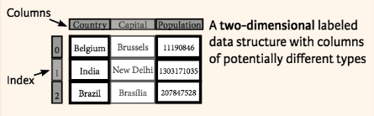
Pandas and Data Frame
Introduction
2D NumPy array – only one data type
Pandas – High level data manipulation tools – can contain multiple data types
Pandas also comes with many useful built-in functions
Data Frame – 2D with both flexible row indices and flexible column names
Import data from sources: CSV, JSON, Excel, SQL, Parquet and many more
>>> data = {'Country': ['Belgium', 'India', 'Brazil'],
'Capital' : ['Brussels', 'New Delhi', 'Brasilia'],
'Population': [11190846, 1303171035, 207847528]}
>>> pd.DataFrame(data, columns=['Country', 'Capital', 'Population'])
Country Capital Population
0 Belgium Brussels 11190846
1 India New Delhi 1303171035
2 Brazil Brasilia 207847528
Notes:
e.g. “Blk 100” is a string although there is a number in it.

Slide 44
Pandas and Data Frame
Use Pandas: Selecting Element
import pandas as pd
Method | Description
iloc[] | Select by Position, multiple values
iat[] | Select by Position, single value, much faster
loc[] | Select by Label, multiple values
at[] | Select by Label, single value, much faster
Data Frame – pd_df
Country Capital Population
0 Belgium Brussels 11190846
1 India New Delhi 1303171035
2 Brazil Brasilia 207847528
Syntax: nd_array[ row , column ]
pd_dict.loc[ row, column ]
In []: pd_df.loc[0:1, ‘Country’]
Out[]:
0 Belgium
1 India
Name: Country, dtype: object
pd_dict.loc[ start : end ]
inclusive:inclusive
Notes:
e.g. “Blk 100” is a string although there is a number in it.

Slide 45
Pandas and Data Frame
Filter: Slicing, Boolean Indexing
Similar to NumPy array, Pandas Data Frame supports Boolean Indexing subsetting
Country Capital Population
0 Belgium Brussels 11190846
1 India New Delhi 1303171035
2 Brazil Brasilia 207847528
Data Frame
>>> pd_df[:][1:2]
Country Capital Population
1 India New Delhi 1303171035
>>> pd_df[pd_df['Population'] > 1200000000]
Country Capital Population
1 India New Delhi 1303171035
Select with Slicing
Boolean Indexing
Notes:
e.g. “Blk 100” is a string although there is a number in it.

Slide 46
Pandas and Data Frame
Data Frame Read and Write
Read and Write to CSV
# Read from CSV
>>> pd.read_csv(‘file.csv’, header=None, nrows=5)
# Write to CSV
>>> df.to_csv(‘myDataFrame.csv’)
Read and Write to Excel
# Read from Excel
>>> df = pd.read_excel(xlsx, ‘Sheet1’)
# Write to Excel
>>> df.to_excel(‘dir/myDataFrame.xlsx’,sheet_name=’Sheet1’)
Notes:
e.g. “Blk 100” is a string although there is a number in it.

Slide 47
Pandas and Data Frame
Data Frame Merge
cid | age | loan
1 | 25 | 0
2 | 30 | NaN
3 | 22 | NaN
data1
data2
cid | age
1 | 25
2 | 30
3 | 22
cid | loan
1 | 0
2 | NaN
4 | 1
# Merge with left join
>>> pd.merge(data1,data2,how=’left’,on=’x1’)
cid | age | loan
1 | 25 | 0
2 | 30 | NaN
4 | NaN | 1
# Merge with right join
>>> pd.merge(data1,data2,how=’right’,on=’x1’)
Notes:
e.g. “Blk 100” is a string although there is a number in it.

Slide 48
Pandas and Data Frame
Data Frame groupby()
Similar to SQL groupby
Split the data into groups based on some criteria
E.g Suppose you have following data frame:
age job
0 30 blue-collar
1 39 services
2 25 services
3 38 admin
4 47 blue-collar
Group age by job and get average age for each job
In []: df.groupby(‘job’).age.mean()
Out[]:
job
admin 38.0
blue-collar 38.5
services 32.0
Notes:
e.g. “Blk 100” is a string although there is a number in it.

Slide 49
Data Cleansing
Missing Values
Poor quality of data caused by missing values
Impacts accuracy of the model predictions in machine learning and data mining
Missing Values Types:
Standard Types - NA, NaN, “”
Non-standard Types - n/a, na, “--”
When reading csv, values that are considered as “missing” can be configured
df[‘Column’].isnull()
# Define custom missing value
missing_values=[“n/a”, “na”, “--”]
df = pd.read_csv(“data.csv”, na_values=missing_values)
Notes:
e.g. “Blk 100” is a string although there is a number in it.

Slide 50
Data Cleansing
Functions
df.method() | Description
isnull() | Returns True if value is missing
fillna() | Replace missing values
dropna() | Drop missing observations
notnull() | Returns True for non-missing values
Data Frame
# Fill 0 for missing data
>>> df.fillna(0)
one two three
a -0.576991 -0.741695 0.553172
b 0.000000 0.000000 0.000000
c 0.744328 -1.735166 1.749580
# Drop missing values
>>> df.dropna()
one two three
a -0.576991 -0.741695 0.553172
c 0.744328 -1.735166 1.749580
one two three
a -0.576991 -0.741695 0.553172
b NaN NaN NaN
c 0.744328 -1.735166 1.749580
Notes:
e.g. “Blk 100” is a string although there is a number in it.

Slide 51
Pandas and Data Frame
Exercise
Notes:
e.g. “Blk 100” is a string although there is a number in it.

Slide 52
Visualization

Slide 53
Matplotlib
What is matplotlib used for?
Matplotlib is a python library that is used for visualisation; graphs and charts
You use Matplotlib to get a visual representation of your data at a glance
Histograms are a quick and easy way to detect anomalies in your data, scatter plots are a quick and easy way to determine data correlations (which is good for machine learning), and bar charts are a great way to visualise the grouping of your data.
For example, when examining credit card transactional data to determine the default risk of married vs unmarried couples, you first want to plot a bar chart to see how much data of married vs unmarried couples you have. If you have data on a lot of married couples, but not a lot of data on unmarried couples, your predictions are going to have bias. You will need to find more data on unmarried couples to do more accurate predictions.
Notes:
e.g. “Blk 100” is a string although there is a number in it.

Slide 54
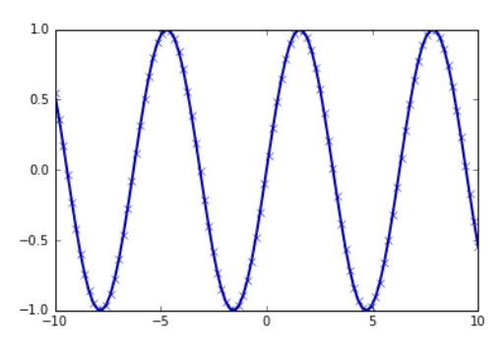
Visualization
Matplotlib Intro
Visualising data is an important step of data exploration and understanding. MatPlotLib is a very popular python library used for visualisations, and can add visualisations directly into your Juypter notebooks.
import matplotlib.pyplot as plt
import numpy as np
%matplotlib inline
# Generate a sequence of numbers from -10 to 10 with 100 steps in between
x = np.linspace(-10, 10, 100)
# Create a second array using sine
y = np.sin(x)
# The plot function makes a line chart of one array
# against another
plt.plot(x, y, marker="x")
Notes:
e.g. “Blk 100” is a string although there is a number in it.

Slide 55
Visualization
Matplotlib Core Concepts
A matplotlib object is constructed out of the following components:
A figure is the overall pane in which the visualisation is drawn. Figures contain Axes, legends, subtitles, and colour bars
An axes is plotted inside the figure, and contains the actual data. A figure can have multiple axes
Each axes has an x-axis and y-axis. Axes contain ticks, labels, legends, and titles themselves
Subplots are to arrange axes in a grid like structure to have multiple plots on one figure
Spines are the lines that form the boundaries around your axes. It’s common only to have a left spine and bottom spine
Pyplot is a handy matplotlib library that abstracts away some complexities to make plotting easier, however for complex plots you will want more control
When plotting to something other than a Jupyter notebook, you will need to plot to the appropriate backend (terminal output, plot to a jpg on your disk, etc)
Notes:
e.g. “Blk 100” is a string although there is a number in it.

Slide 56
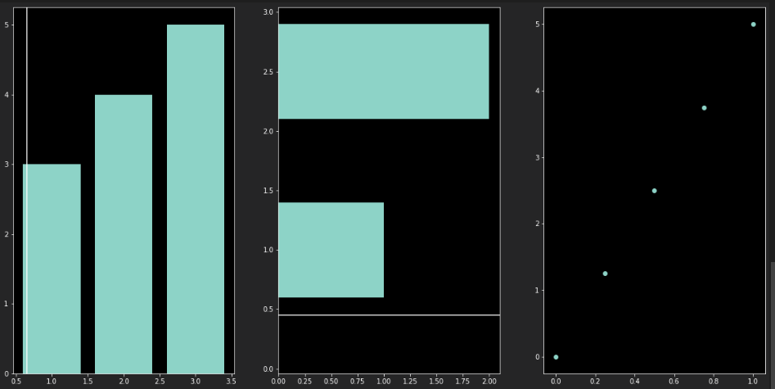
Visualization
Matplotlib – The Code
# Import `pyplot` from `matplotlib`
import matplotlib.pyplot as plt
# Initialize the plot
fig = plt.figure(figsize=(20,10))
ax1 = fig.add_subplot(131)
ax2 = fig.add_subplot(132)
ax3 = fig.add_subplot(133)
# Plot the data
ax1.bar([1,2,3],[3,4,5])
ax2.barh([0.5,1,2.5],[0,1,2])
ax2.axhline(0.45)
ax1.axvline(0.65)
ax3.scatter(np.linspace(0, 1, 5), np.linspace(0, 5, 5))
# Show the plot
plt.show()
Notes:
e.g. “Blk 100” is a string although there is a number in it.

Slide 57
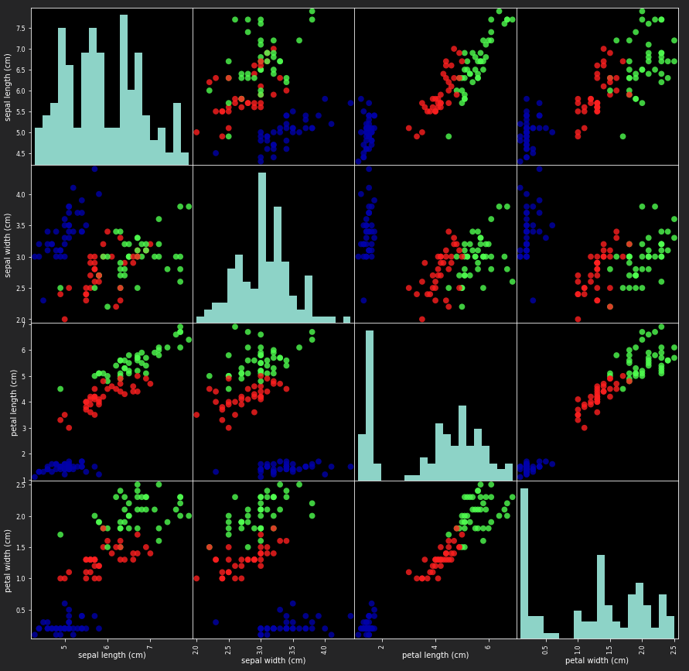
Visualization
Matplotlib – The Code
# create a scatter matrix from the dataframe, color by y_train
pd.plotting.scatter_matrix(iris_df,
c=y_train,
figsize=(15, 15),
marker=‘o’,
hist_kwds={'bins': 20},
s=60,
alpha=.8
)
Notes:
e.g. “Blk 100” is a string although there is a number in it.

Slide 58
Visualization
Exercise
Notes:
e.g. “Blk 100” is a string although there is a number in it.

Slide 59
Self-learning and Next Steps

Slide 60
Resource
Pandas Documents: https://pandas.pydata.org/pandas-docs/version/0.23.4/generated/pandas.DataFrame.html
Python Data Science Handbook: https://jakevdp.github.io/PythonDataScienceHandbook/03.01-introducing-pandas-objects.html
Python for Finance: Analyze Big Financial Data by Yves Hilpisch
Python Cheat Sheets: https://github.com/abhat222/Data-Science--Cheat-Sheet/blob/master/Python/python-cheatsheets-ds.pdf
Paid + Free Learning: https://www.datacamp.com
Citi Data Flame:
Notes:
e.g. “Blk 100” is a string although there is a number in it.

